Slide 1
Core Course
Generative AI
VIth Semester AY 2024-25
Chapter-6
Generative Models II: Large Language Models (LLMs)
(2-0-1)

Slide 2
Large Language Models (LLMs)
A Large Language Model (LLM) is a type of artificial intelligence model designed to understand, generate, and manipulate human-like text. These models are based on deep learning architectures, primarily transformers, and are trained on massive datasets to predict and generate text.
LLMs are widely used in applications like chatbots, content creation, translation, and more.
Large, general-purpose language models can be pre-trained and then fine-tuned for specific purposes
Large : Training dataset & number of parameters
General-purpose : Commonality of human languages (ex: GPT, llama)
Pre-trained : General-purpose models trained on diverse datasets
Fine-tuned : Tailored to specific tasks or domains using additional data.

Slide 3
Large Language Models (LLMs) : Types
LLMs are mainly classified into three (3) types
Generic: These predict the next word based on the language in the training data.
Instruction tuned: Trained to predict the response to the instructions given in the input.
Dialog Tuned: Trained to have a dialog by predicting the next response
Type | Key Feature | Example Model | Primary Use Case
Generic | Predict next word | GPT-2 | Text generation, summarization
Instruction Tuned | Follow instructions explicitly | InstructGPT | Task-specific outputs
Dialog Tuned | Engages in coherent multi-turn dialog | ChatGPT | Conversations, virtual assistants

Slide 4
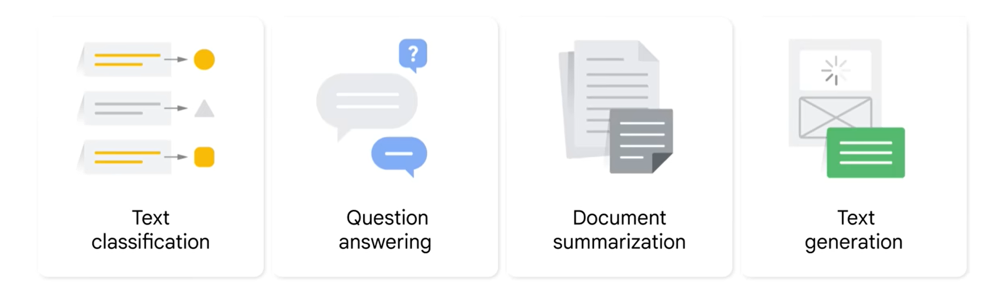
Large Language Models (LLMs) : Applications
Where are LLMs Used?

Slide 5
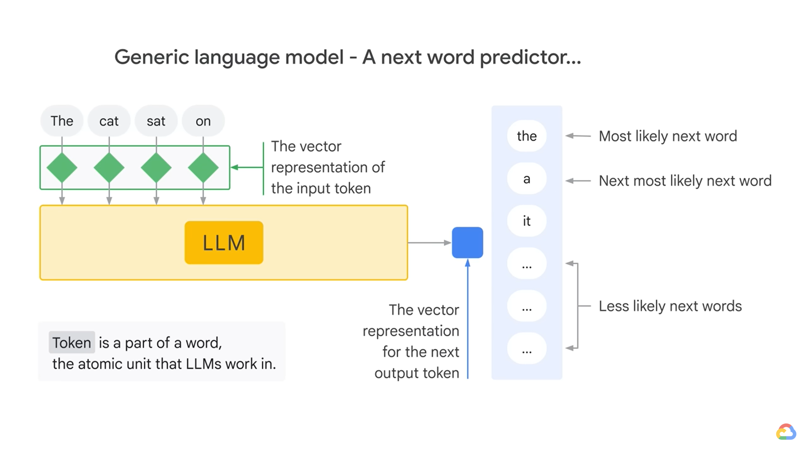
Large Language Models (LLMs) : Types
Generic LLMs
How language models predict the next word.
Input tokens (small text units) are converted into vectors (tokenization) and processed by the LLM to understand context.
The model then calculates probabilities for possible next words, ranking them by likelihood, enabling it to generate coherent and contextually relevant text.

Slide 6
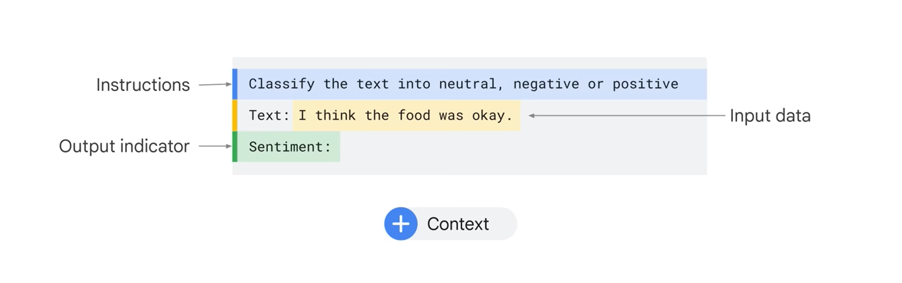
Large Language Models (LLMs) : Types
Instruction Tuned LLMs
An Instruction tuned LLM can adapt to specific styles or patterns of applications.
Example: Write an email in my style

Slide 7
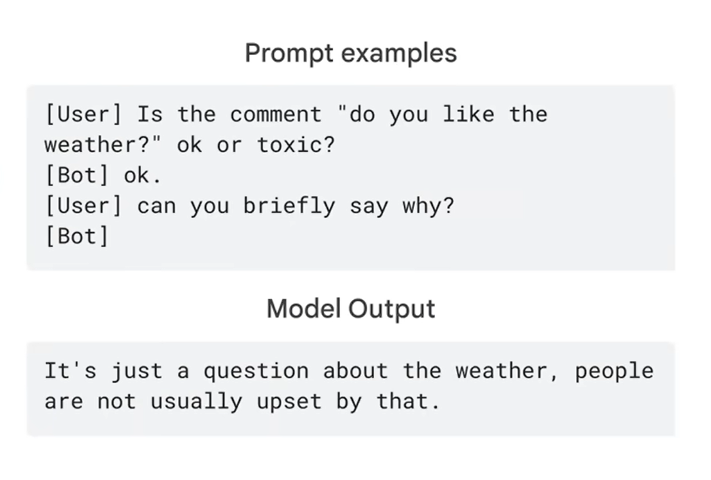
Large Language Models (LLMs) : Types
Dialog Tuned LLMs
A dialog-tuned LLM (Language Model) is a type of AI model fine-tuned specifically for interactive conversations.

Slide 8
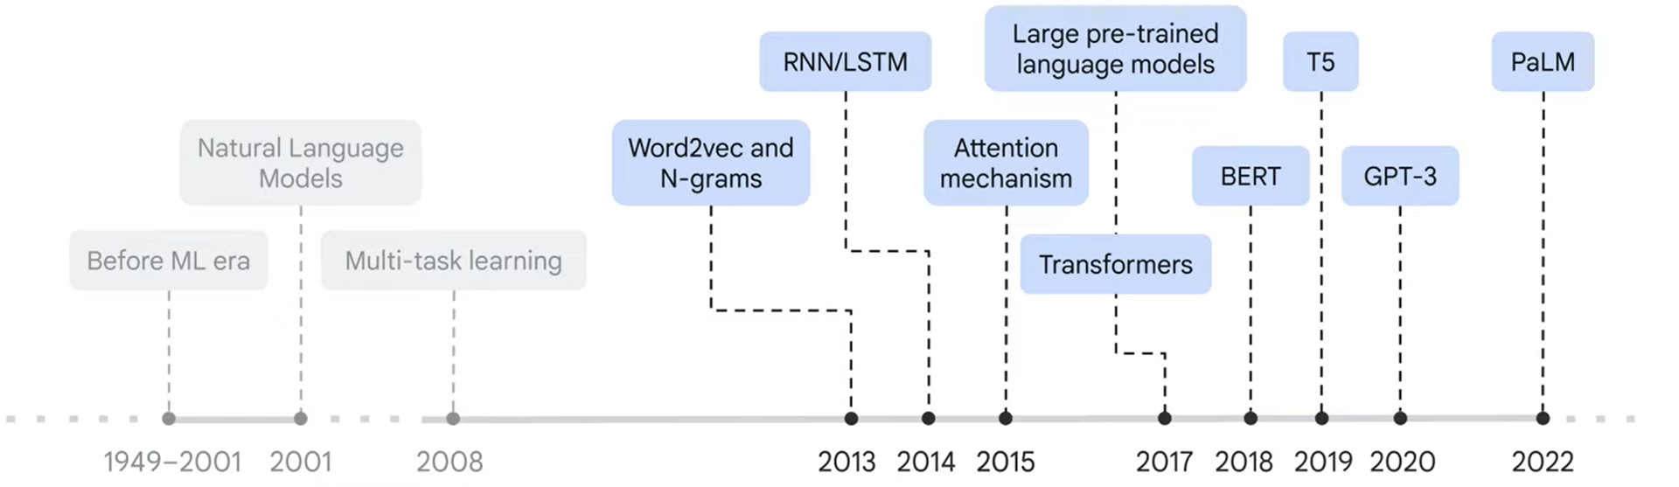
Large Language Models (LLMs) : Evolution
RNN/LSTM (2014) Ex: Speech recognition.
Attention Mechanism (2015) Ex: Show, Attend and Tell (Xu et al., 2015), where the model generated captions for images by attending to different regions.
Transformers (2017) Ex: BERT, ChatGPT, T5.

Slide 9
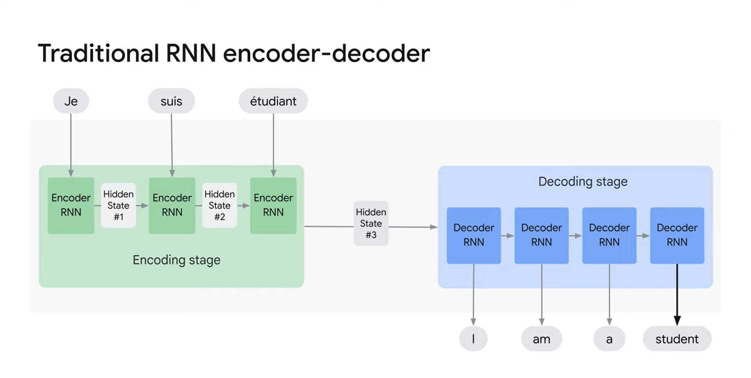
Large Language Models (LLMs) : Evolution
RNN/LSTM: Recurrent Neural Network/ Long Short-Term Memory
Recurrent Connections: Enables information from the past to influence the current output.
LSTM (Long Short-Term Memory): Introduced gating mechanisms to handle long-term dependencies.
Recurrent Loop: Allows the network to retain information from previous time steps by reusing the hidden state
Encoder: Encodes the input sequence into a fixed-size context vector (hidden state) that summarizes the input information.
Hidden states are vectors that capture information about the sequence being processed. They act as a form of memory, allowing the network to retain and process information over time.
Decoder: Produces output at each time step.

Slide 10
Large Language Models (LLMs) : Evolution
RNN/LSTM: Limitations
Vanishing/Exploding Gradients: While LSTMs addressed this better than vanilla RNNs, they still struggled with learning long-term dependencies in very long sequences.
Sequential Processing: Data had to be processed step-by-step, making them computationally expensive and slow for long sequences.
Limited Parallelism: RNNs cannot process sequence elements in parallel, leading to slow training times.
Context Decay: Even with LSTMs, retaining distant contextual information effectively in long sequences was a challenge.
Limitation: Traditional RNN-based models struggle with long sequences because the context vector cannot retain all information effectively.

Slide 11
Large Language Models (LLMs) : Integration of LLMs in various generative tasks
1. Integration via APIs and Frameworks
APIs (like OpenAI's GPT API) allow developers to send prompts and receive generated outputs, enabling easy embedding into apps, websites, or platforms.
Frameworks (like LangChain, LlamaIndex) help orchestrate complex tasks, such as chaining multiple model calls or integrating LLMs with databases or search engines.
2. Text Generation
Use Case: Article writing, storytelling, summarization.
Integration: Embed LLMs in writing platforms (e.g., Jasper, Notion AI).
Enhancements: Fine-tuning or prompt engineering for tone/style.

Slide 12
Large Language Models (LLMs) : Integration of LLMs in various generative tasks
3. Code Generation
Use Case: Auto-completion, code refactoring, explanation.
Integration: Plugged into IDEs (e.g., GitHub Copilot with VS Code) via extensions using Codex or similar models.
Interaction: Real-time suggestions based on context-aware prompts.
4. Conversational Agents
Use Case: Customer support, chatbots, virtual assistants.
Integration: LLMs combined with dialogue management systems and backend APIs.
Frameworks: Rasa, Botpress with LLM-based NLP layers.

Slide 13
Large Language Models (LLMs) : Integration of LLMs in various generative tasks
Use Case: AI-Powered Customer Support Chatbot
Objective:
To automate customer service using a natural, responsive, and intelligent chatbot that can handle queries, escalate issues, and provide solutions.
Integration Flow:
Frontend Interface:
A chat window on a website or app where users type questions.
LLM (e.g., GPT-4) via API:
The user’s input is sent to the LLM via OpenAI’s API.
The LLM interprets the intent and generates a natural-language response.
Retrieval-Augmented Generation (RAG):
To improve accuracy, the system may first search internal knowledge bases (e.g., FAQs, product manuals) and feed that context to the LLM.
Tools like LangChain or LlamaIndex can orchestrate this step.
Decision Layer:
If the query is sensitive or complex, the LLM is programmed (via prompt or code logic) to escalate to a human agent.
Otherwise, it sends the response back to the user.
Optional Logging & Feedback:
User feedback is logged to improve future responses, using fine-tuning or prompt engineering.

Slide 14
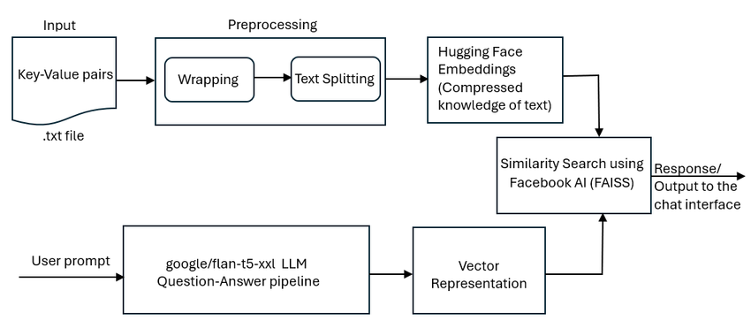
Large Language Models (LLMs) : Integration of LLMs in various generative tasks
LLM Integration in Customer Support Chatbot
https://www.researchgate.net/figure/Architecture-for-implementation-of-chatbot-using-LLM_fig2_379181825

Slide 15
Large Language Models (LLMs) : Integration of LLMs in various generative tasks
Key Components Explained
User Interface (UI):
Function: Allows customers to interact with the chatbot via text input.
Example: A chat window on a website or mobile app.
Input Preprocessing:
Function: Cleans and structures user input for better understanding.
Techniques: Tokenization, normalization, and intent detection.
LLM (e.g., GPT-4):
Function: Processes the cleaned input and generates a contextually relevant response.
Capabilities: Understands nuances, handles complex queries, and provides human-like responses.
Knowledge Base Integration:
Function: Provides the chatbot with access to a repository of information (e.g., FAQs, product manuals).
Enhancement: Allows the chatbot to provide accurate and detailed answers.

Slide 16
Large Language Models (LLMs) : Integration of LLMs in various generative tasks
Key Components Explained
Response Generation:
Function: Combines LLM output with knowledge base information to craft a comprehensive reply.
Considerations: Ensures the response is coherent, relevant, and helpful.
Post-Processing:
Function: Refines the generated response for tone, clarity, and appropriateness.
Techniques: Grammar correction, sentiment adjustment, and personalization.
User Feedback Loop:
Function: Collects user feedback to improve future interactions.
Methods: Ratings, surveys, or direct comments.

Slide 17
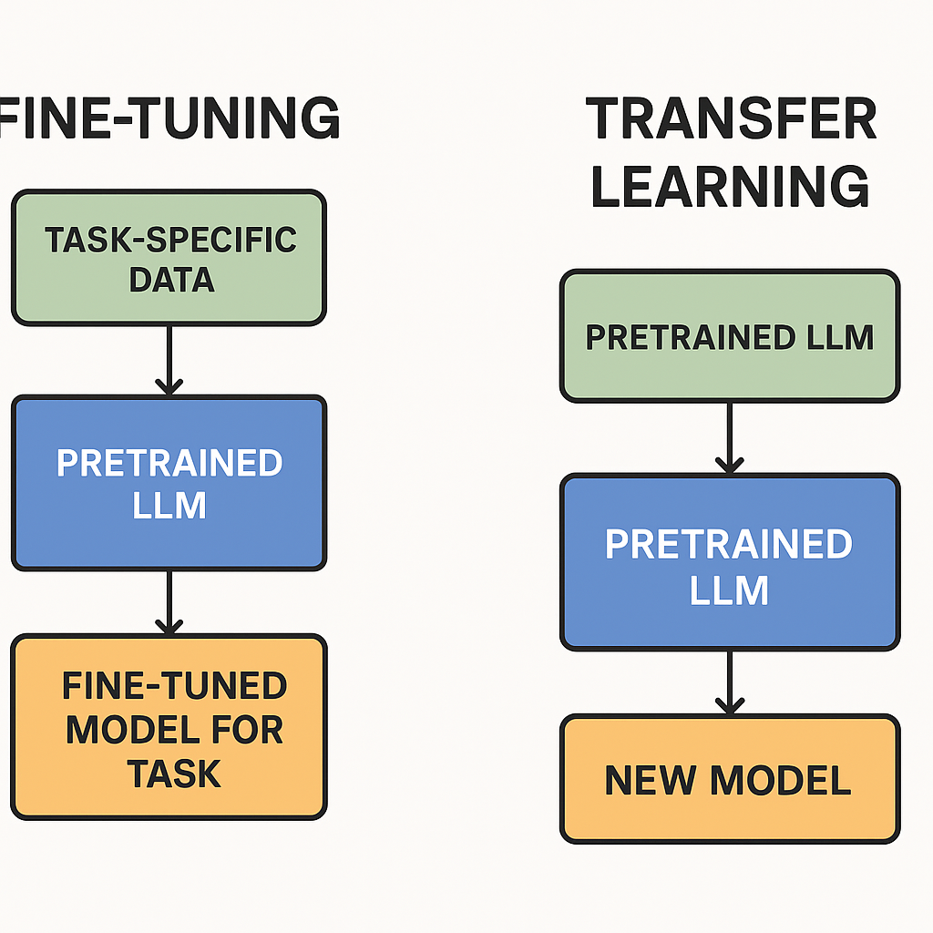
Large Language Models (LLMs) : Fine-tuning and transfer learning with LLMs
Aspect | Fine-tuning | Transfer Learning
Goal | Adapt an already-trained model to a specific task or dataset. | Use the knowledge learned from a pre-trained model for a new but related task.
Starting Point | Pretrained LLM | Pretrained LLM
Main Idea | Update the model weights by continuing training on new (task-specific) data. | Either freeze or lightly update the model while reusing its general capabilities.

Slide 18
Large Language Models (LLMs) : Fine-tuning and transfer learning with LLMs
Fine-Tuning LLMs
Definition: Continue training a pre-trained LLM on a smaller, domain-specific dataset to specialize it for a particular task.
Goal: Adapt the model to specific needs (e.g., legal text summarization, medical diagnosis chatbots).
Training: Updates many or all of the model’s parameters.
Data Size: Requires a moderate amount of labeled data (less than pretraining but still substantial).
Cost: Computationally expensive (full or partial retraining).
Risks:
Overfitting if the dataset is small.
"Catastrophic forgetting" — the model might lose some general capabilities.

Slide 19
Large Language Models (LLMs) : Fine-tuning and transfer learning with LLMs
Fine-Tuning LLMs
Techniques to improve:
LoRA (Low-Rank Adaptation) — efficient fine-tuning by adding low-rank matrices.
Adapter Layers — small trainable modules inserted into the model.
Full fine-tuning vs. Partial fine-tuning — tuning selected layers only.

Slide 20
Large Language Models (LLMs) : Fine-tuning and transfer learning with LLMs
Transfer Learning with LLMs
Definition: Use a pre-trained LLM’s learned knowledge to solve a new task without extensive retraining.
Goal: Leverage the general "language understanding" to handle different tasks.
Training:
Zero-shot: Use the model without additional training (just clever prompting).
Few-shot: Provide a few examples inside the prompt to guide it.
Light fine-tuning: Retrain only a small part (e.g., final layers).
Data Size: Can work with very little data (especially in few-shot settings).
Cost: Much cheaper than full fine-tuning.
Risks:
May not achieve perfect task performance if the new domain is very different from pretraining.
Benefits:
Very fast adaptation and No need for huge task-specific datasets.

Slide 21
Large Language Models (LLMs) : Fine-tuning and transfer learning with LLMs
Summary Table
Feature | Fine-Tuning | Transfer Learning
Model Parameters | Updated extensively | Mostly reused, minimal updates
Data Required | Medium | Small to none
Compute Cost | High | Low
Flexibility | Highly task-specific | General adaptation
Risk | Overfitting, forgetting | Performance limit on very different tasks

Slide 22
Large Language Models (LLMs) : End-to-End Process: Building and Deploying LLM-Based Applications
1. Problem Definition & Use Case Design
Before touching code:
Identify target users and pain points
Define the scope: classification, summarization, question answering, chatbot, code generation, etc.
Decide on model interaction: retrieval-augmented generation (RAG), fine-tuned LLM, or zero-shot/few-shot prompt engineering

Slide 24
Large Language Models (LLMs) : End-to-End Process: Building and Deploying LLM-Based Applications
2. Model Selection
Options:
Hosted APIs: OpenAI, Anthropic, Cohere, Google Gemini — fast to prototype, minimal infra.
Open-source models (local/self-hosted):
Hugging Face models (GPT-2/3-class, LLaMA, Mistral, Falcon, etc.)
DeepSpeed, vLLM, Exllama for inference optimization
Consider:
Model size (7B, 13B, 65B parameters)
License type (commercial vs non-commercial)
Hardware availability (A100/H100 GPUs or CPU clusters)

Slide 25
Large Language Models (LLMs) : End-to-End Process: Building and Deploying LLM-Based Applications
4. Backend & Inference Infrastructure
A. For Hosted APIs
API gateway (FastAPI, Flask, Express)
Handle rate limiting, retries, and error management.
B. For Self-hosted Models
Model deployment framework:
vLLM (very efficient)
Hugging Face Text Generation Inference (TGI)
DeepSpeed inference server
Serve over REST/gRPC
Containerize: Docker
Orchestrate: Kubernetes (if scaling)
Hardware:
Cloud: AWS EC2 P4/A100 instances, Azure ND-series, GCP A2/H100
On-prem: multi-GPU servers
3. Application Design
Determine interaction pattern:
Chat interface
API call
Document search (RAG)
Multi-modal input (text, image, audio)
Define:
Input validation
Prompt engineering or instruction tuning
Output formatting

Slide 26
Large Language Models (LLMs) : End-to-End Process: Building and Deploying LLM-Based Applications
5. Frontend / UI Layer
Web app: Next.js, React.js, Vue.js
Chat interface: Chat UI libraries (Streamlit, Gradio, or custom)
Mobile: React Native / Flutter
6. Optional: Retrieval-Augmented Generation (RAG)
For domain-specific knowledge:
Vector database: FAISS, Chroma, Milvus, Weaviate
Embed text: Sentence Transformers, OpenAI Embedding API, Hugging Face
Search relevant documents before LLM prompt call
Combine retrieved context with user input via templated prompt

Slide 27
Large Language Models (LLMs) : End-to-End Process: Building and Deploying LLM-Based Applications
7. Fine-tuning / Instruction Tuning (if needed)
Collect domain-specific Q&A, conversations, or code samples
Fine-tune with Hugging Face Transformers or PEFT (Parameter-Efficient Fine-Tuning: LoRA, QLoRA)
Use 8-bit/4-bit quantization for large models
Save and serve fine-tuned model
8. Monitoring, Logging & Metrics
Key for production stability:
LLM response time, latency, token usage
Prompt inputs/outputs logs
Error rates & fallbacks
Tools: OpenTelemetry, Prometheus + Grafana, Langfuse, Helicone

Slide 28
Large Language Models (LLMs) : End-to-End Process: Building and Deploying LLM-Based Applications
9. Deployment & Scaling
CI/CD pipelines: GitHub Actions, GitLab CI, Jenkins
Container registry: Docker Hub, AWS ECR, GCP Artifact Registry
API Gateway: Kong, Nginx, or AWS API Gateway
Scaling:
Autoscaling on K8s
Load balancing
Model sharding for large models
10. Security & Governance
API authentication: OAuth2, API keys, JWT
Prompt injection attack prevention
Rate limiting
Content moderation: filters for harmful content
Data privacy compliance: GDPR, HIPAA, etc.

Slide 29
Thank you

